Slide 1

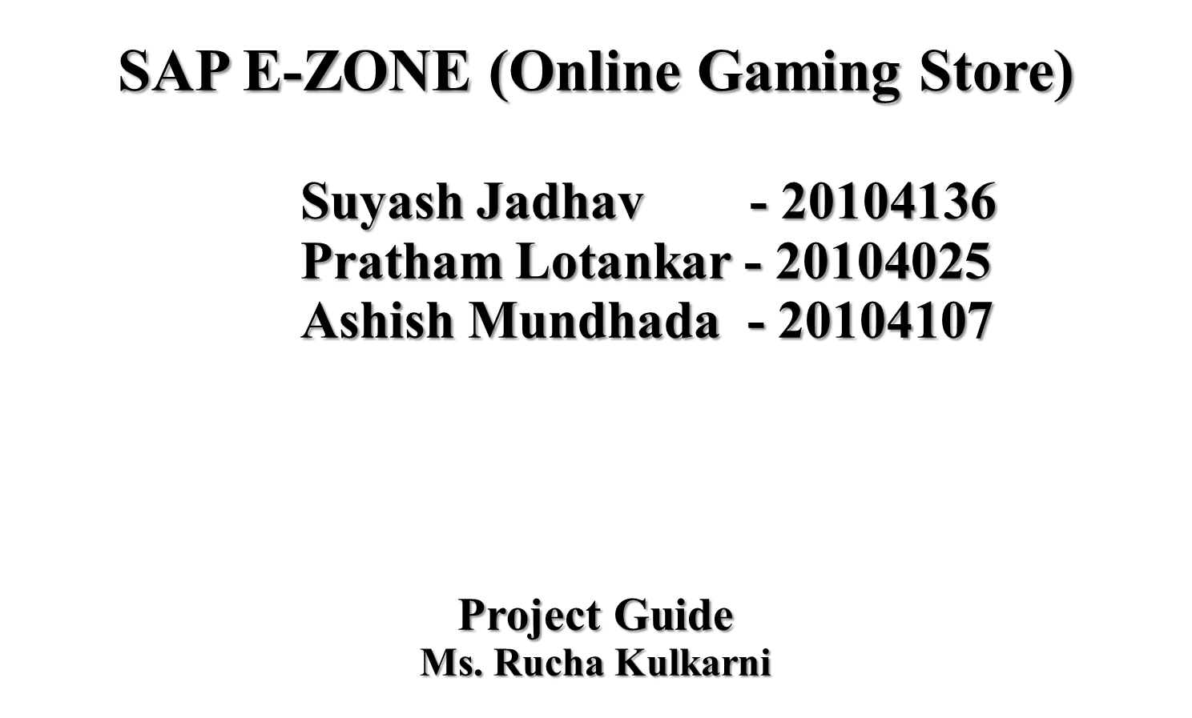

Slide 2
Contents
Introduction
Objectives
Scope
Literature Survey
Proposed System
Project Outcomes
Use case Diagram
Technology Stack
Suggestion in Review 1
Result and discussion
Conclusion and future scope
References

Slide 3
1. Introduction
SAP E-zone is basically a Gaming library with numerous games and various gaming equipments available to purchase at discounted price by the Customer as per their use.
SAP E-zone also provides customers to know information about no.of esports org and players existing in Indian Gaming community.
People in India don’t have a proper website to look up games and their equipments( Pc,console and mobile) on one site. There are sites which don’t have mobile gaming equipments needed for streaming like El-gato and Gaming finger sleeves etc.

Slide 4
2. Objectives
To provide hassle free services to the customers.
To increase efficiency of purchase.
To manage the payments for the customers.
To generate reports on games, payments.
To expand the knowledge of E-sports to area where there is insufficient knowledge of gaming.

Slide 5
3. Scope
To pursue gaming as a profession/career in India.
Instead of getting corrupted physical data disk from store ,customer will purchase our gaming products online which will be installed for lifetime access once it is purchased.
This platform saves time and money as well with a very commendable price.
To build a Customer friendly web based application.
To provide customers with detailed information about availability of games and gaming gears.

Slide 6
4.Literature Survey –A data driven survey of video games
The video game industry is one of the fastest growing of entertainment industries, with a variety of platforms, genres and cutting-edge technologies. Built upon the cultural heritage and supported by the culmination of hardware and software advancements, video games have evolved as a most interactive cultural medium. While PC and console gaming has been the norm during the golden age of video games, mobile technologies have emerged during the last decade, with potential to disrupt the gaming industry as well. In this study, a survey of game scores over the years reveals some general trends in the industry, from the perspective of end users. The average scores, number of titles, as well as a distribution by genre are extracted from Metacritic database and plotted to show an overview of the PC gaming industry since the inception of user scores and reviews on game-related websites and the implications for traditional gaming in the future.
Published in: 2020 12th International Conference on Electronics, Computers and Artificial Intelligence (ECAI) Publisher: IEEE

Slide 7
5. Proposed System
    Allows to make a secured socket layer payment.
    Unified Payment Interface (UPI) for hassle free payments.
    An average Indian online gamer :
    A. is a below 24 year male
    B. is introduced to online gaming through their friends, family and peer group
    C. is engaged in gaming for stress relief and social interaction
    Male gamer are concerned about data and memory consumption; Female gamer seek regular update / upgrade.

Slide 8
6. Project Outcomes
User will register .
User will login and purchase.
User will search for various gaming equipment's he requires.
User will choose their particular gaming device equipment's for PC, mobile and console via filter .
User will securely pay via UPI method and receive the desired product in the particular medium .

Slide 9
7. Block Diagram
Start
Login Page
No
Registration Page
Yes
Home Page
Login
Games
Equipments
FAQ
Reviews
About Us
Feedback
Make a purchase
End

Slide 10
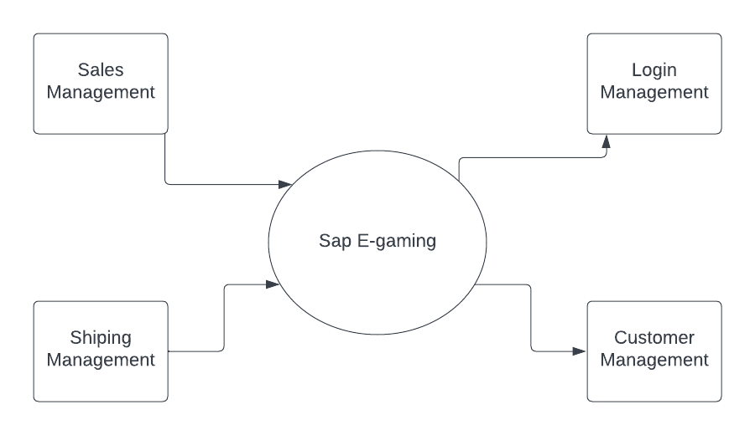
Zero level DFD:

Slide 11
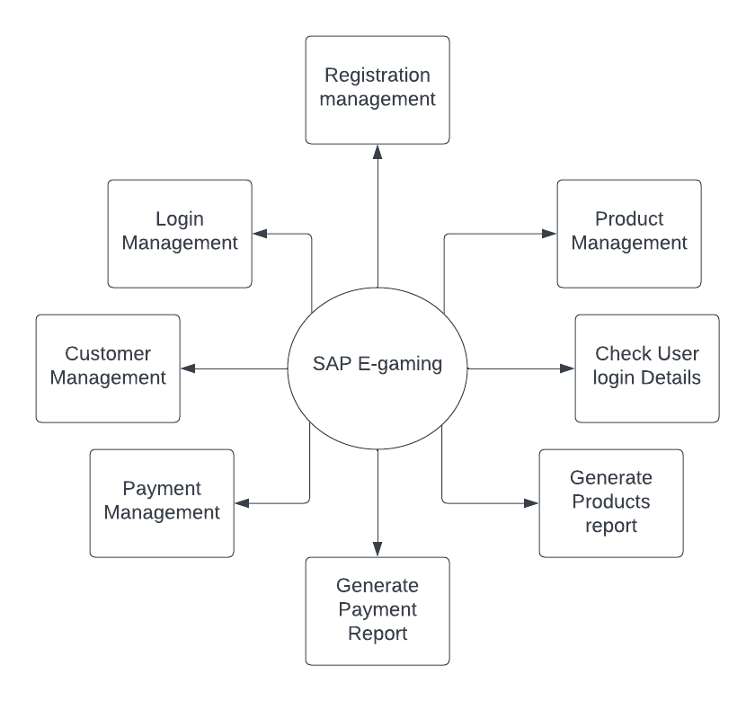
First level DFD:

Slide 12




6. Technology Stack
Frontend - HTML (Hyper text markup language), CSS and Javascript
Backend - Firebase
Unified Payments Interface

Slide 13
Suggestions in Review 1
Insertion of Games (prices)
Insertion of Product Description
Insertion of Search Bar
Insertion of Filter (Sorting products)

Slide 14

Results and Discussion
Navbar header:
Footer:

Slide 15
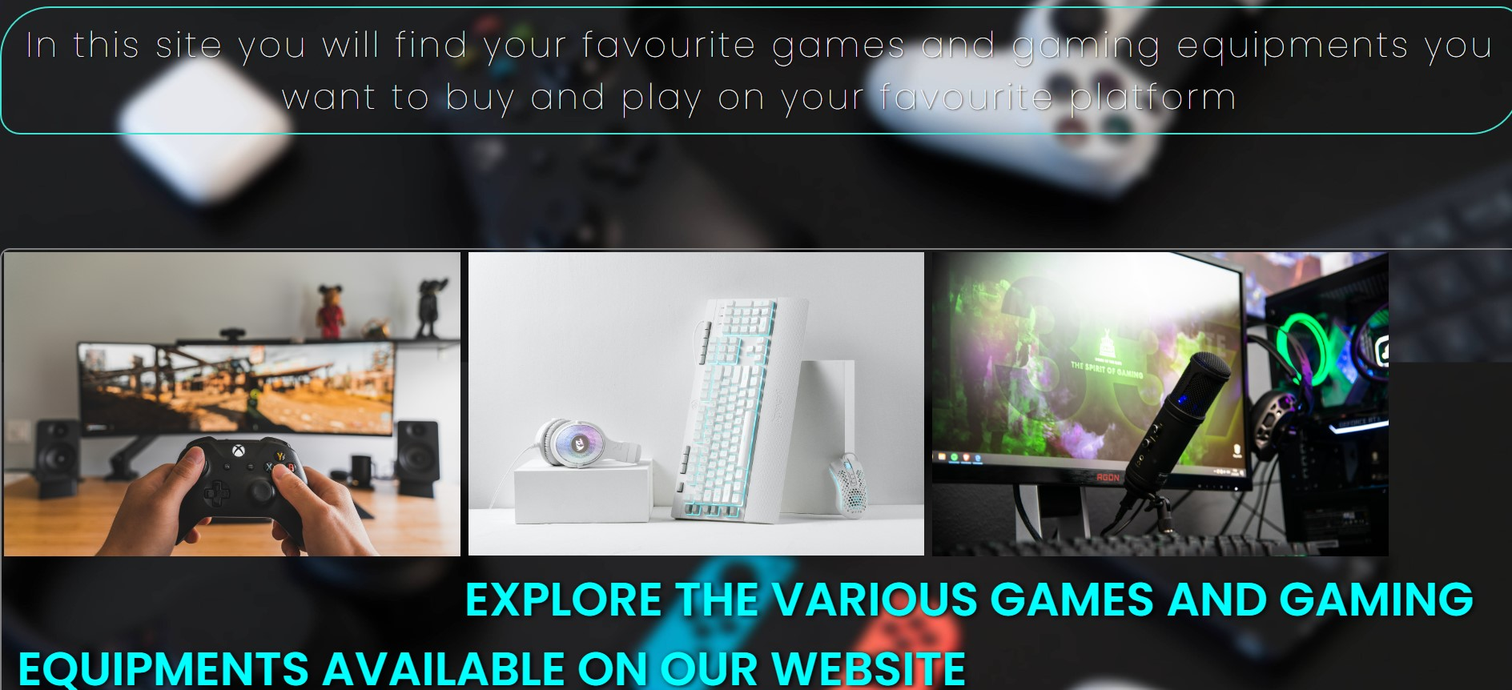

Slide 16
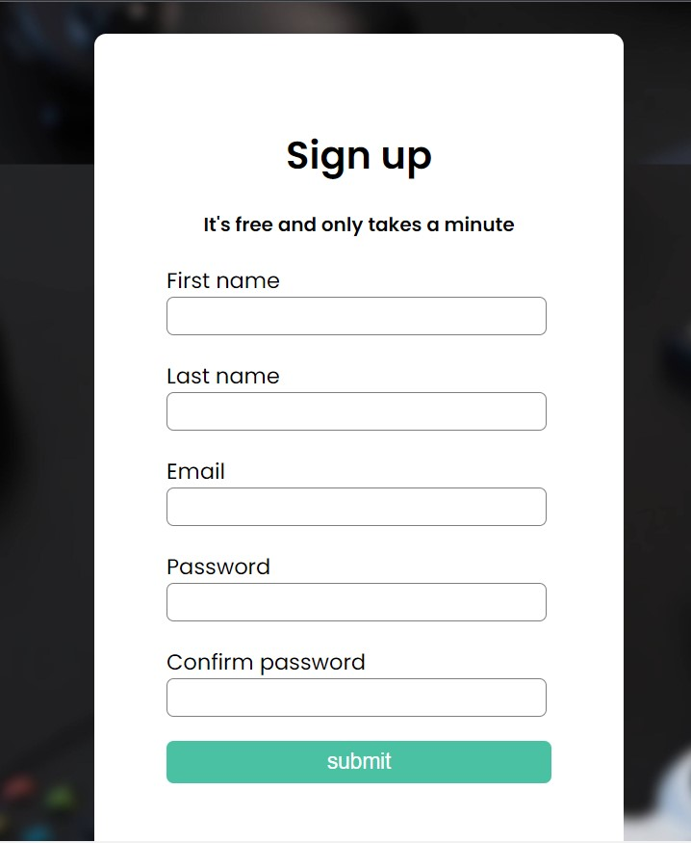
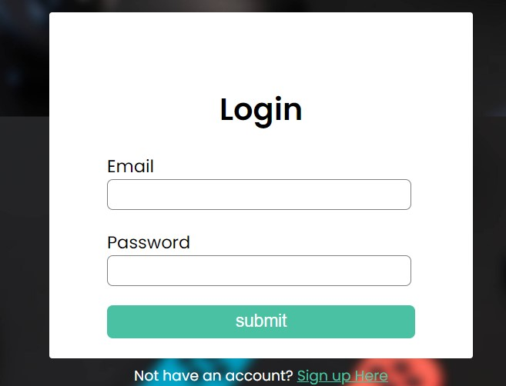

Slide 17
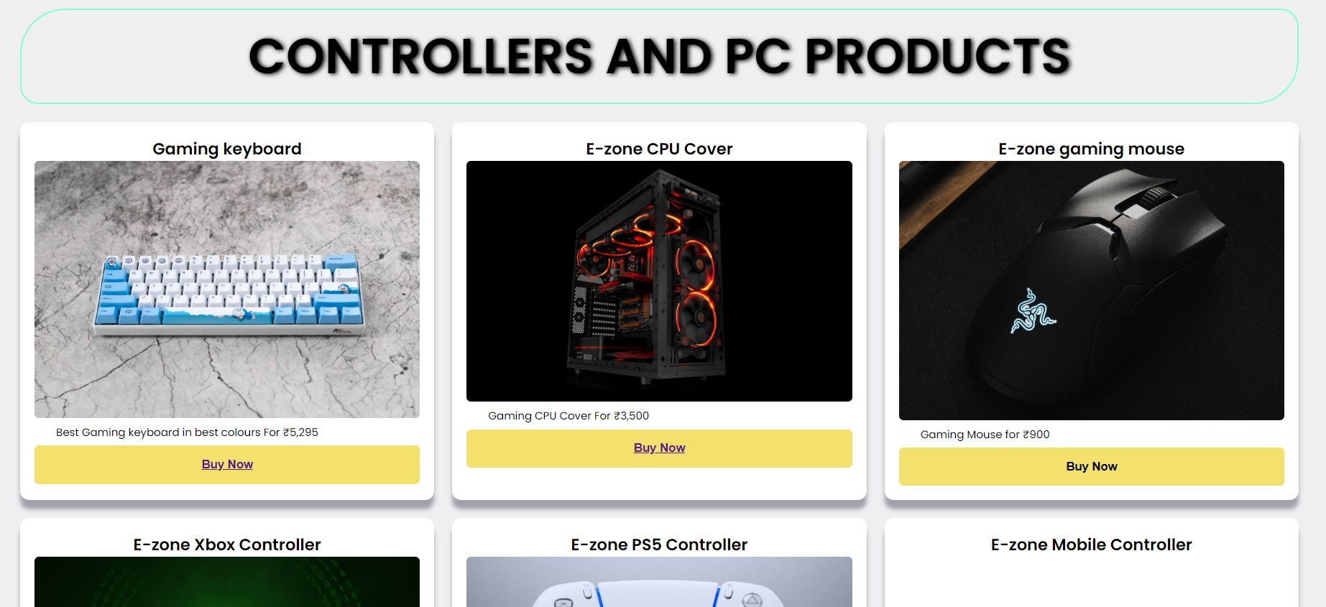
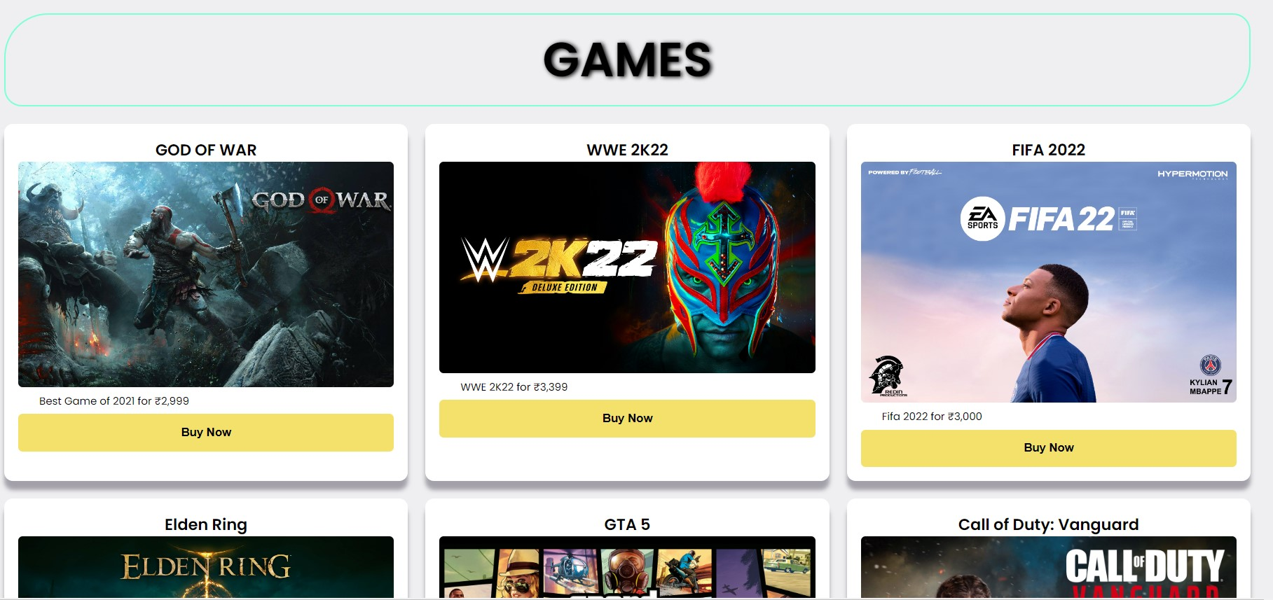

Slide 18
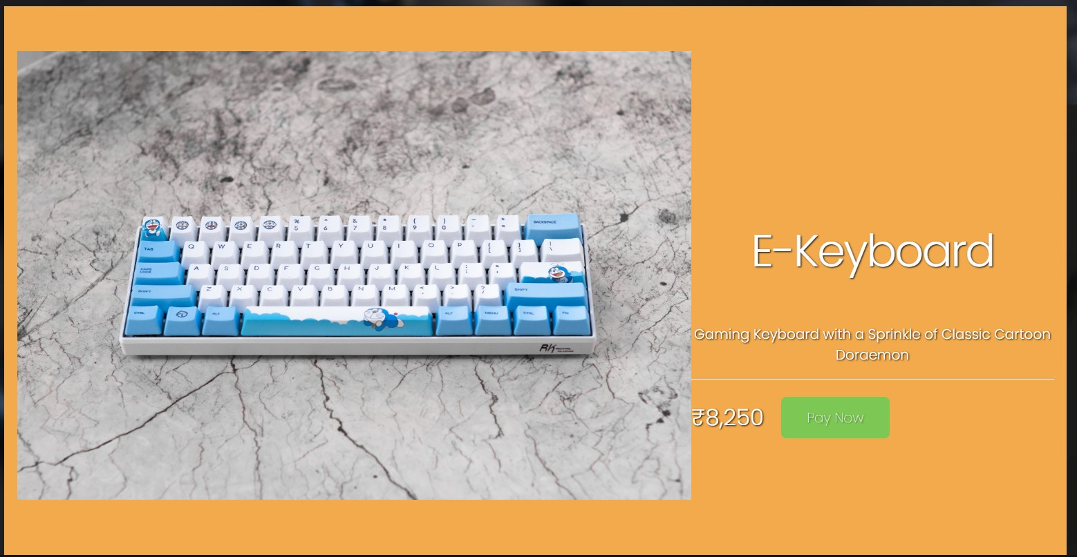
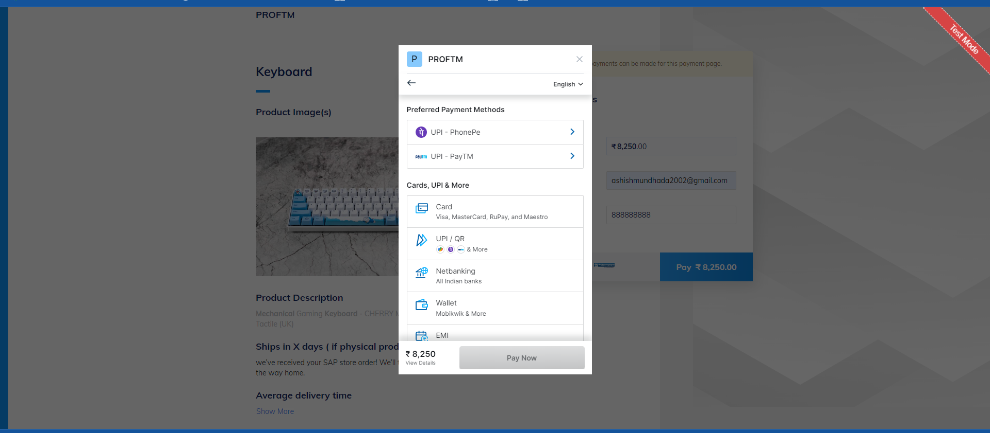

Slide 19
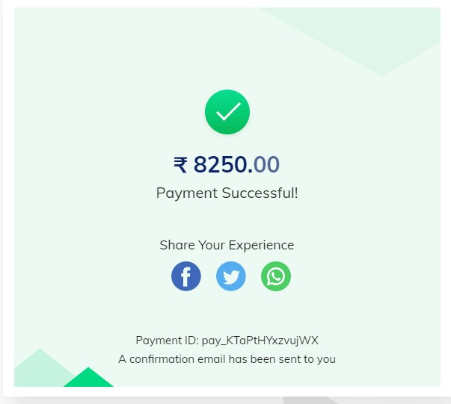
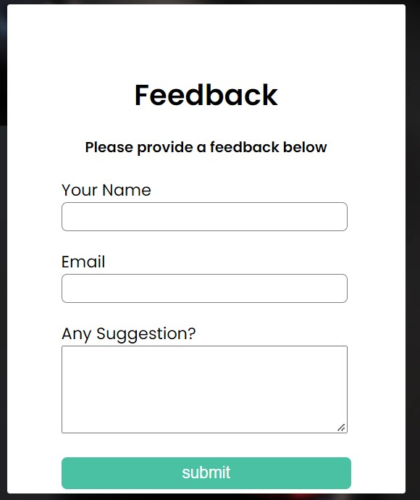
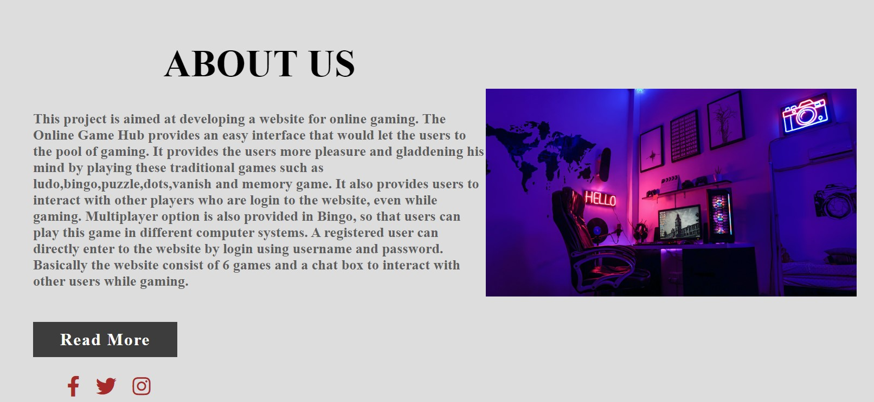

Slide 20
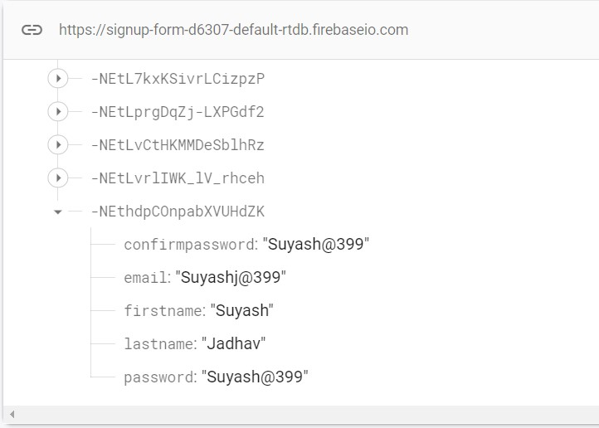
Backend

Slide 21
12. Conclusion and Future Scope
To conclude, SAP E = GAMING works like a component which will access all the available facilities and performs various functions.
Admin Panel:-
        Admin will be included in future to manage products, manage payment, manage sales and Manage User login Details.
The project has a very vast scope in future.
It will be implemented in various fields in future.
It will also be updated in the future as and when requirement for the same arises, as it is very flexible.

Slide 22
13. References
[1]https://www.ijeit.com/Vol%203/Issue%209/IJEIT1412201403_42.pdf. [2]https://ieeexplore.ieee.org/document/6040828/authors#authors.
[3]https://www.slideteam.net/tag/contact-management-system-powerpoint-templates-ppt-slides-images-graphics-and-themes.
[4]https://www.slideserve.com/inara/contact-management-system-powerpoint-ppt-presentation.

Slide 23
Thank You...!!

